Slide 1
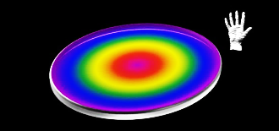
color-based remote
Meredith Shelby

Slide 2
Movement
SPECS
discus-shaped
1/10^{t}” - 1/2” thickness
diameter 4cm
radius 2cm
circumference 12.56
area 12.56 cm
lightweight-plastic
color
touch
swirl

Slide 3
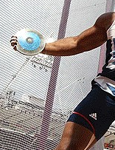

UX
looks like a discus
held like a discus
smaller
lightweight

Slide 4
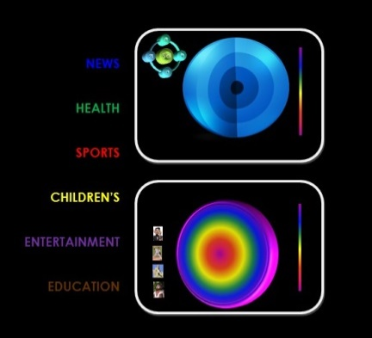
Sol Sys
Sol
movies
health
university
sports

Slide 5











Sports
Search:
10:00 | 10:30 | 11:00
Swimming | Field hockey | Tennis
Sports Desk | Around the goal | UK Soccer News
Vikings v. Chicago | Cowboys v. Redskins | Dolphins v. Chargers
NCAA news desk | NCAA Updates | Year in NCAA
DIY
NFL
Movies
Reality
FIFA
NCAA
Drama
Childrens
Gymnastics
Tennis
Education
News
News
Health
Children
Sports
Movies

Slide 6


Search:
10:00 | 10:30 | 11:00
Swimming | Field hockey | Tennis
Sports Desk | Around the goal | UK Soccer News
Vikings v. Chicago | Cowboys v. Redskins | Dolphins v. Chargers
NCAA news desk | NCAA Updates | Year in NCAA
Downtown Abbey
Arthur
Antiques Roadshow
Curious George
Frontline
Sid Science
Julia Childs
Sesame Street
NBR
News
Health
Children
Sports
Movies

Slide 7

World News
Search:
10:00 | 10:30 | 11:00
Swimming | Field hockey | Tennis
Sports Desk | Around the goal | UK Soccer News
Vikings v. Chicago | Cowboys v. Redskins | Dolphins v. Chargers
NCAA news desk | NCAA Updates | Year in NCAA
NPR
CNN
BBC
FOX
CBC
News
Health
Children
Sports
Movies

Slide 8


mapping
News
PLANET
News
Network
Interest
Genre
You set up your search preferences

Slide 9
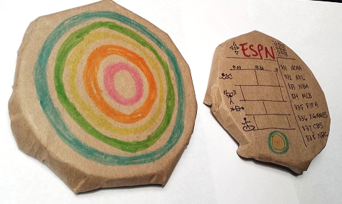
2D|3D prototype
Items to add to my blog:
Watched how to hold & throw a discus
https://www.youtube.com/watch?v=KytMRh2j_T8
Searched discus & CD images
Created story boards of UX
12/8/14
Meredith Shelby

Slide 11
Sol
entertainment
health
university
sports
News
Health
Children
Sports
Movies
Search:

